Slide 1



Team:
Jessica Martinez
Mohammed Saad
Scott Murray
Team:
Jessica Martinez
Mohammed Saad
Scott Murray
Team:
Jessica Martinez
Scott Murray
Mohammed Saad

Slide 2
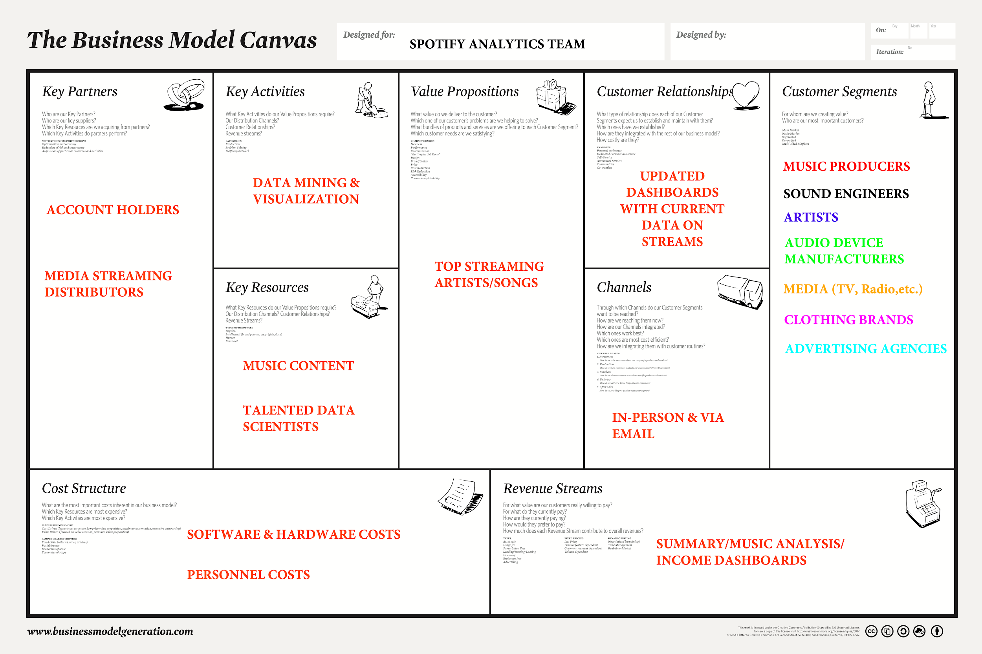

Slide 3
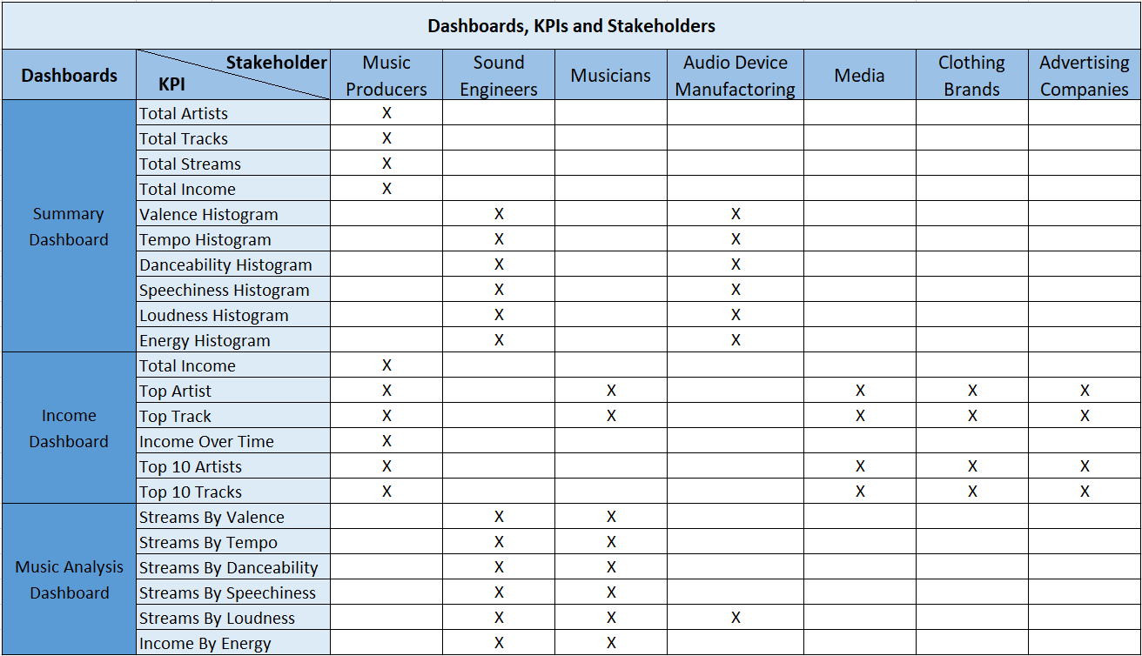
Notes:
https://www.youtube.com/watch?v=RGY9Do5bZqg
https://www.youtube.com/watch?v=6bpC0Vu0sUk
2017-Kendrick Lamar’s Humble -The NBA playoff theme song-The NBA finals had 20.4 million viewers which was the most since 1998 (Golden State Warriors vs. Cavaliers)
2017-Kendrick Lamar a headliner at Coachella
2018-The Weeknd & Post Malone performed at Coachella

Slide 4
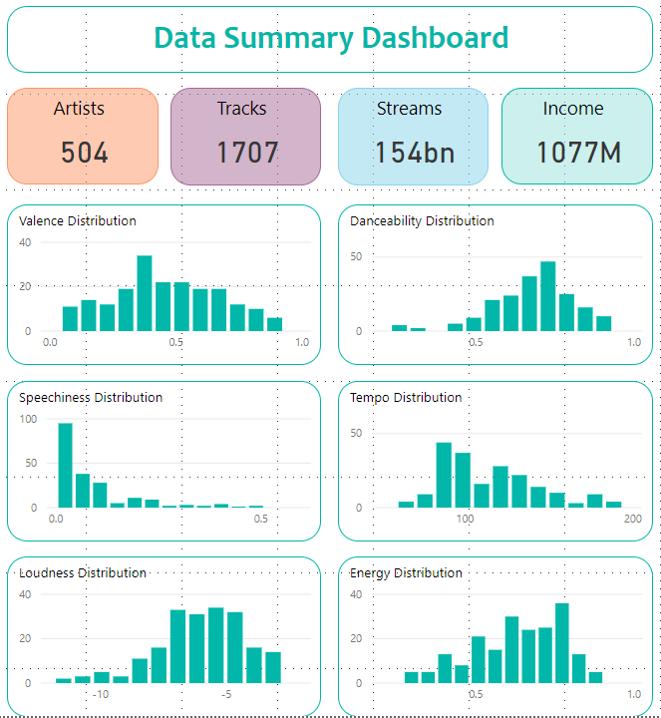
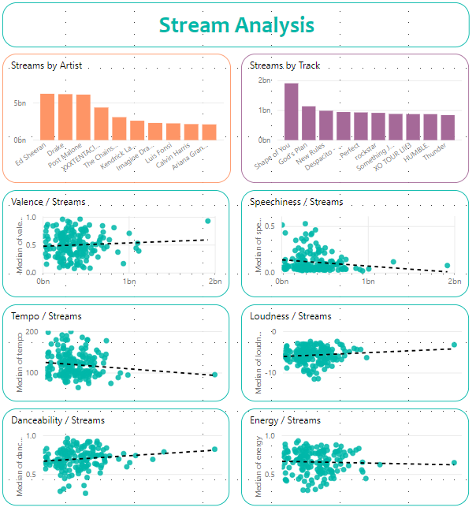
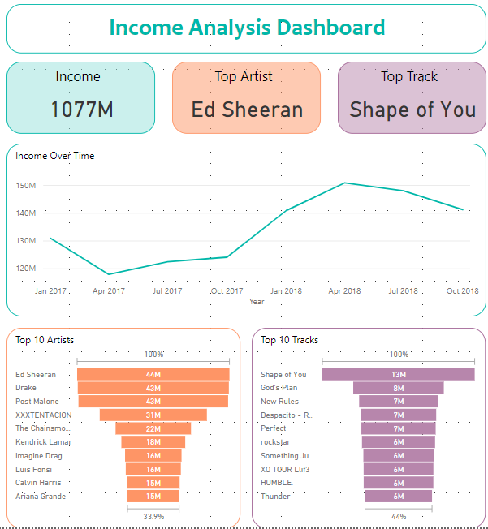
Power BI Dashboards
Published to Power BI Service
Interactive Visuals
Demo (link)

Slide 5
Using SPSS for Principal Component Analysis

Slide 6
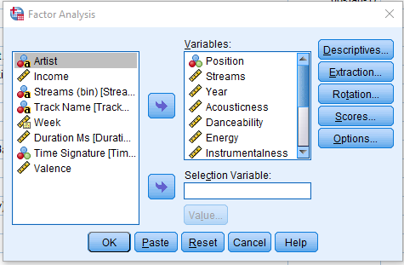
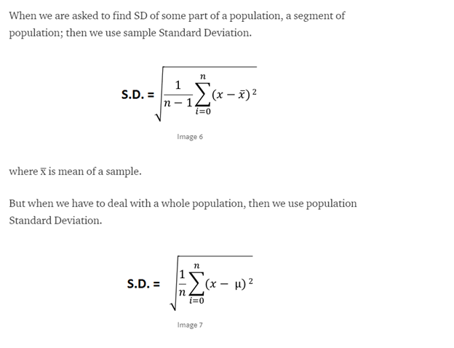
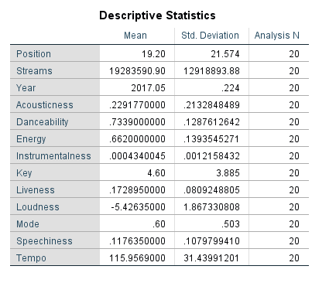
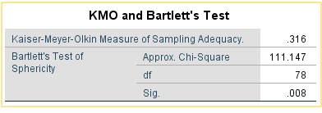

Slide 7
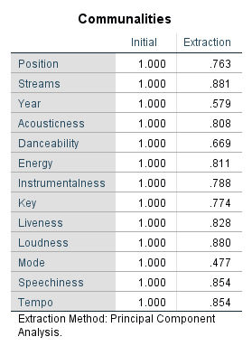
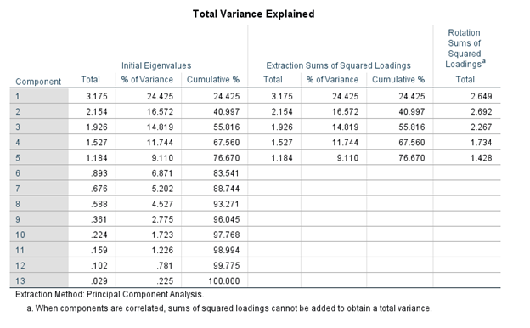
Extraction of 13 Components of 20. Which shows the percentage of variance.
Later on the top 5 variance are retained in order to modify the current stats.

Slide 8
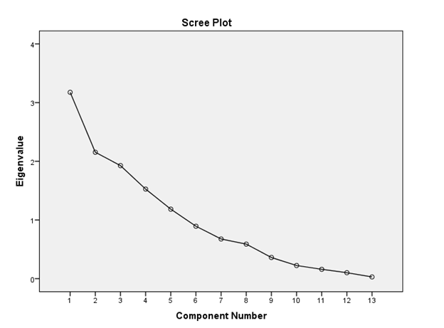
Scree plot for Eigenvalues v/s 13 components.
Curve shows the deviations, which denotes the variance in regards to the extracted components.

Slide 9
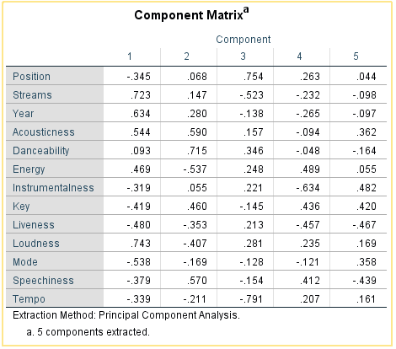
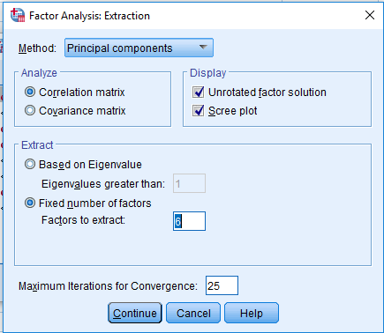
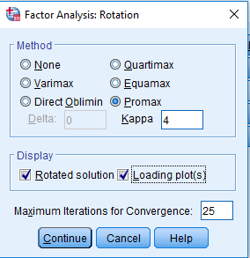
We can forcefully change the number of extracted components.

Slide 10
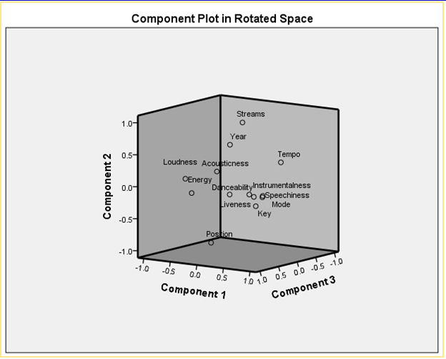
Plot depicts the favourable components in the analysis which are shown on the positive side of the plot. Where as the on the negative side components are to be avoided for analysis.

Slide 11





Than You Questions?
TThank You

